Slide 1

Trade Master (GMOT application)
Developed by : Shashwat Arya

Slide 2
Thinking Process
I decided to start with making a complete back-end with all the necessary APIs. It would then help me produce an intuitive UI design which integrates all the services seamlessly.
After the back-end design, I moved onto the front-end keeping in mind Schneiderman’s 8 golden rules for interface design. It allowed me to produce a simplistic and clean design that had all the necessary functionality.
After integrating the back and front-ends, I finally moved to adding additional features that would improve both the performance and efficiency of the application.
Design an efficient back-end
Design a user-friendly front-end
Look for ways to improve performance and functionality

Slide 3
Design Considerations
I tried to integrate the following considerations in my website –
Scalability – Website features a microservice architecture that allows functionality to be added and removed without much code change (eg. Adding new types of queries).
Clean and friendly UI – Keep the UI simple and consistent (color scheme and components) for a fulfilling user experience.
Separation of data and logic – This would allow the microservices to be designed without any dependency on the data. It would allow for more code re-use and easy maintenance.
Why a website – Having a website over an app gives the advantage to the developer to have an OS independent code-base for both, computer and a phone. Moreover, I could leverage open-source technologies like ReactJS and Django that have plenty of community support available.

Slide 4


Architecture
Back-end server
running on Django
Front-end API architecture built on Axios
ReactJS based website.
Admin panel to make changes without touching the code
REST APIs for queries
(micro-services)
File Parser
Database
(SQLite)
Back-end
Front-end

Slide 5
DataBase Design
Foreign key takes an integer value, therefore reducing the lookup time
Trade
Client (Foreign Key)
Date
TradeID
ReportingSide
Regulation
Jurisdiction
SecuritiesFinancingTransactionType
Client
ClientId
EntityId
LEI (bool)
REPORTING_CONSENT (bool)
AML_KYC (bool)
isGTT (bool)
DataBase tables to store query data. In this way, the query conditions can be changed without touching the code
Jurisdiction
EU
UK
Regulation
SFT_REPORTING
Reporting Counter Party
FNB-EU
FNB-UK
Reporting Side
FIRM
Securities Type
BUY_BACK
MARGIN_LENDING
REPURCHASE
SECURITIES_LENDING

Slide 6
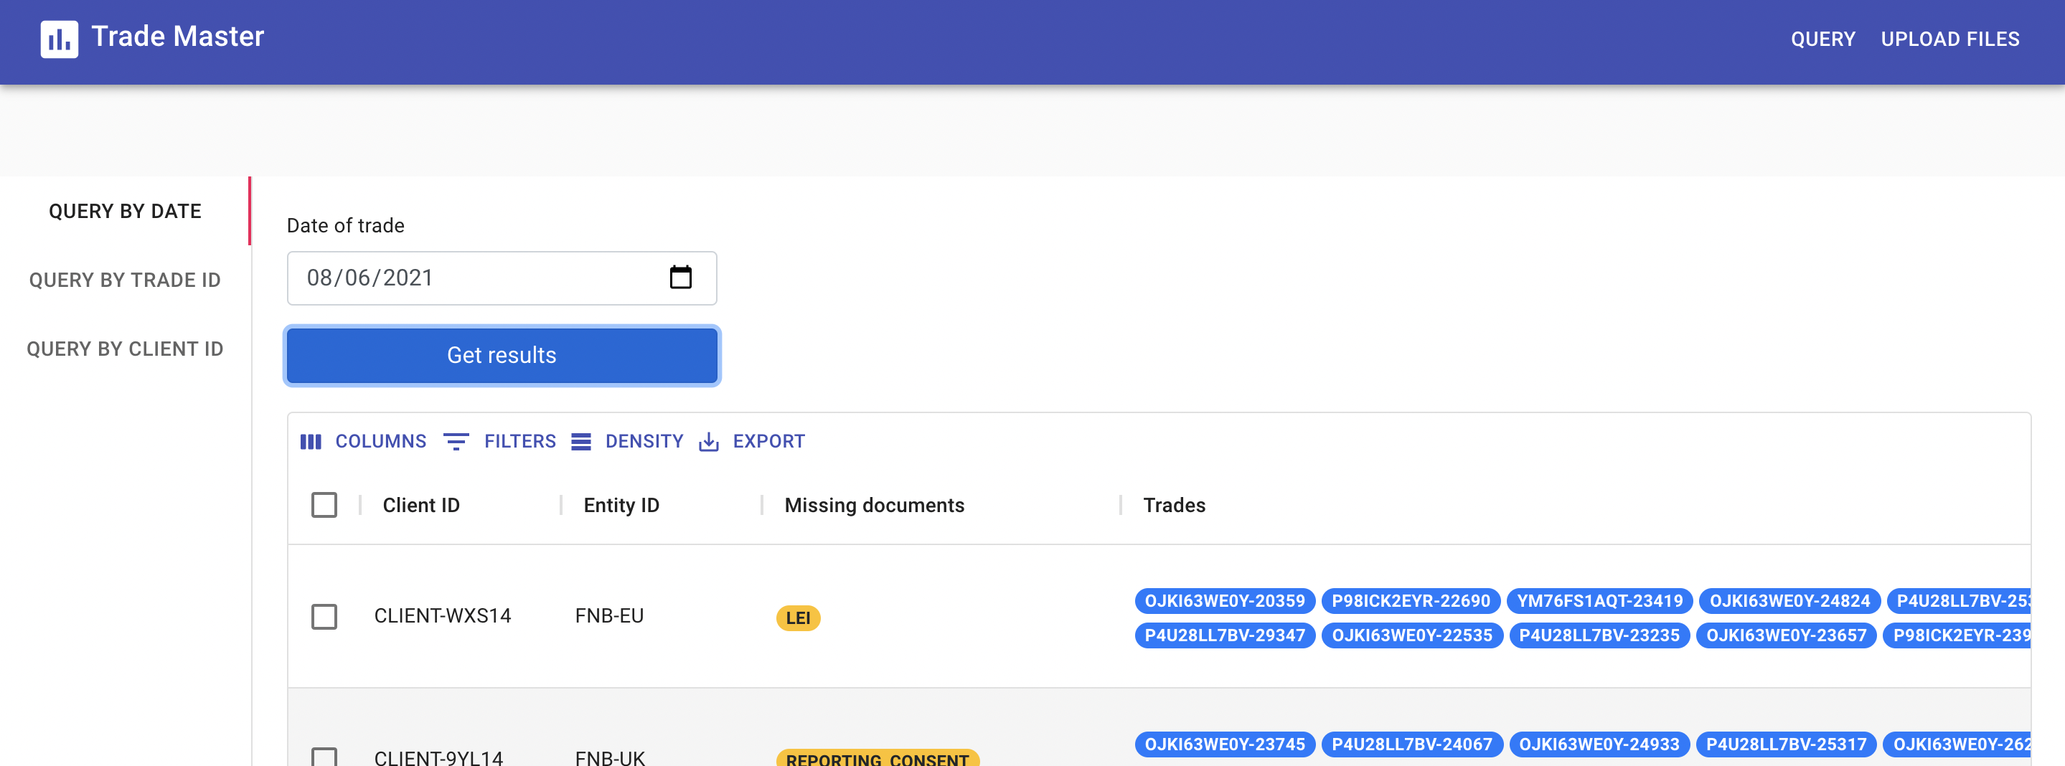
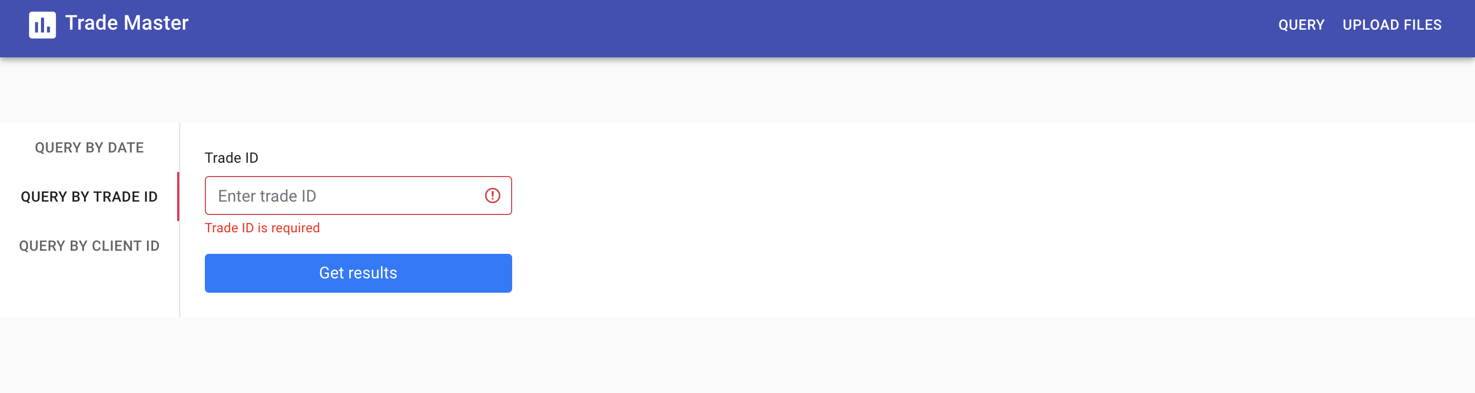
Front-end
Built on ReactJS and leverages Axios for making API calls to the back-end. Features tab navigation and tables for a clean display of query data.
The vertical tabs allow for additional query types to be added quite easily.
Other functionalities -
Separate front-end API architecture (under src/services) to allow API changes and error handling.
Validation for all input fields.
Navbar to switch between “Query” and “Upload Files” screens.
“query by date” page
Input validation

Slide 7
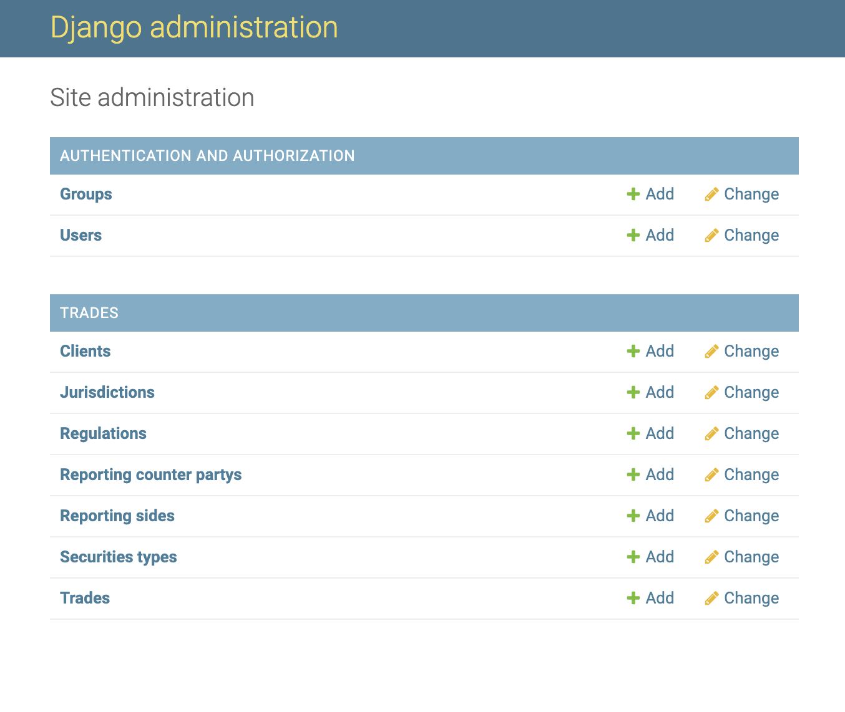
Back-end
Built with Django and SQLite, the server is capable of handling multiple concurrent requests. It also has an an admin panel to view and change DataBase content.
This allows for easy functionality change without touching the code (eg. changing the jurisdiction for GTT check).
Other functionalities -
DataBase indexes for faster queries
Separate APIs for each service
JSON Parser to extract info from uploaded files and insert into DB
Tables to store GTT checks
Django admin panel

Slide 8
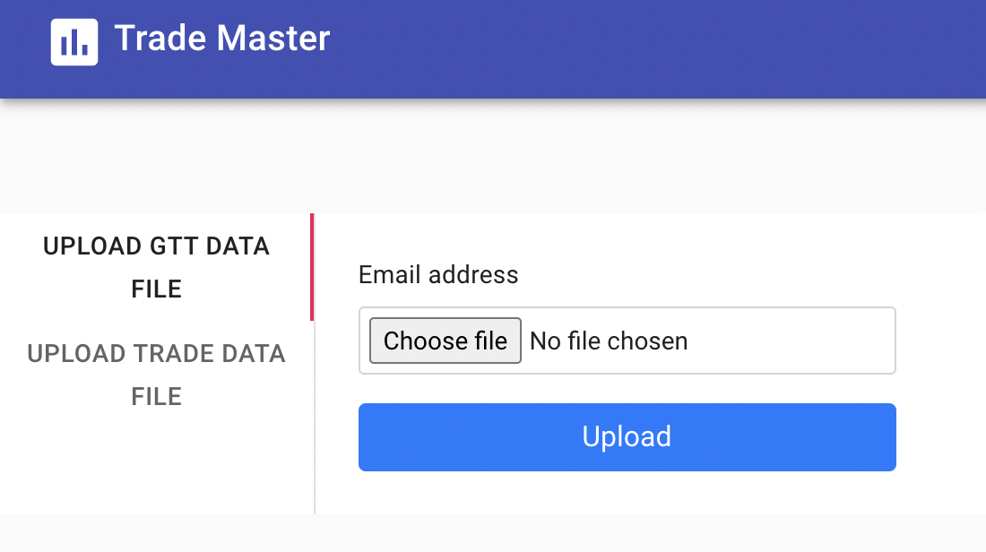
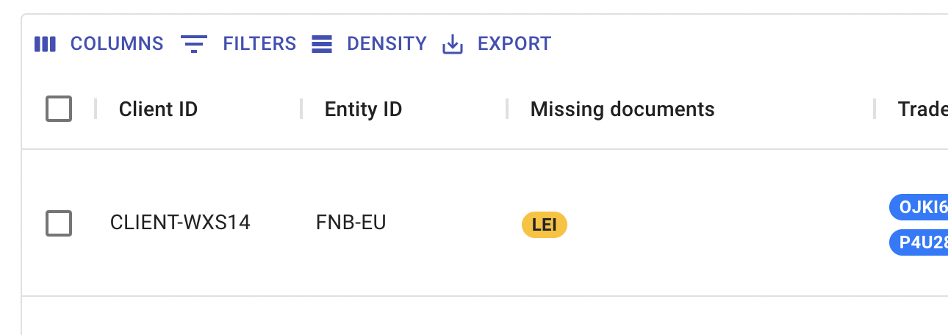
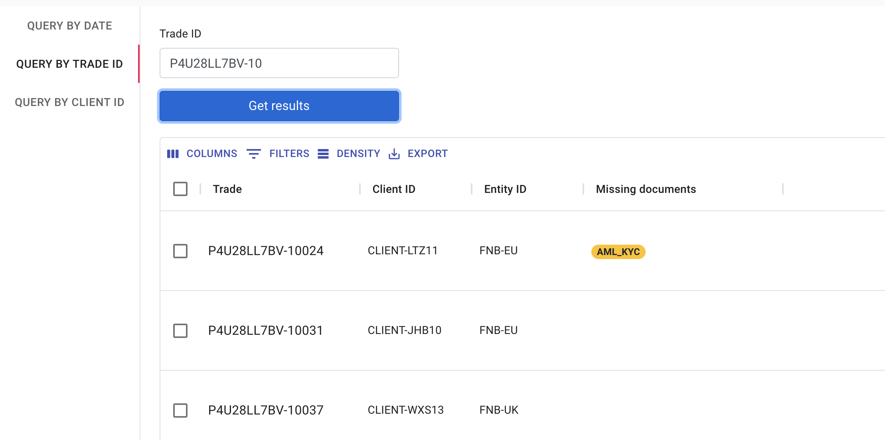
Improvements Made
API to upload GTT and Trade data files and parse them in the back-end.
DataBase table indexing to improve lookup time.
Query by Trade ID allows search even by partial ID. It returns all the trade IDs that contain the search string.
Ability to export query result in a CSV format.
Ability to filter query results by column name.
Upload Files page
(bool)
Buttons to Filter and Export Data
Trade ID query by partial ID

Slide 9
Future Improvements
Project Scaling – When the website users reach a certain threshold, the DataBase queries can take some considerable time due to the volume of information stored. To remedy this, Elastic Search can be implemented. It stores and retrieves a large amount of data in real time.
DataBase – SQLite isn’t ideal for large websites that require concurrency. Therefore, when the user base grows, the current DataBase can be migrated to PostgreSQL. It handles large volumes of data much better.
Authentication – Services like uploading files to store in the DB should not be available to every user. Hence, the next step would be to implement user authentication so only the admins can access certain services.
User Interface – As the application grows, so would the functionality provided to the users. Certain design practices would need to be implemented in order to maintain the overall consistency of the website.

Slide 10



Things Learned
Frame-works
Programming
languages

Slide 11
Challenges Faced
New to Django – When I stared development, I had not worked with Django before. Therefore, I had to learn it within two days to leave sufficient time for my front-end design.
Dependency issues – While working with React, I had to use several open-source libraries. Some of these libraries had dependency issues with the version of node. I was able to solve the problem by looking for alternative libraries.
Choosing the right UI – Throughout development, I went back and forth with several design options. My aim was to make the UI as simple as possible without compromising the functionality. I finally settled on a simplistic design based on the color palette of Bank of America.

